Slide 1
Organometallic Chemistry- II
Dr. Semanti Basu
Assistant Professor
Department of Chemistry
Bejoy Narayan Mahavidyalaya
Itachuna, Hooghly, W. B., India

Slide 2
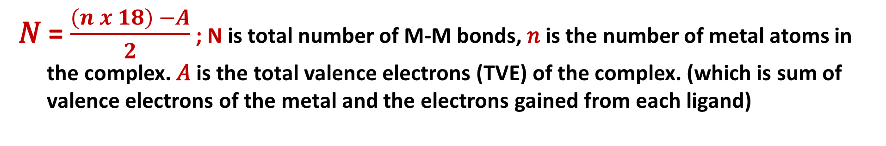
How to determine the total number of metal - metal bonds
𝑁 = $\frac{\left(n x 18\right) −A}{2}$; N is total number of M-M bonds, 𝑛 is the number of metal atoms in the complex. 𝐴 is the total valence electrons (TVE) of the complex. (which is sum of valence electrons of the metal and the electrons gained from each ligand)
Molecule | TVE (A) | (18 × n) – A | Total M–M bonds | Bonds per metal (18-A/n) | Basic geometry of metal atoms
Fe₃(CO)₁₂ | (3x8)+(12x2)=48 | (18x3)=54 54 – 48 = 6 | 6/2 = 3 | 48/3 = 16; 2
Co₄(CO)₁₂ | (4x9)+(12x2)=60 | 72 – 60 = 12 | 12/2 = 6 | 60/4 = 15; 3
[η⁵-CpMo(CO)₂]₂ | 30 | 36 – 30 = 6 | 6/2 = 3 | 30/2 = 15; 3 | Mo≡Mo
(η⁴-C₄H₄)₂Fe₂(CO)₃ | 30 | 36 – 30 = 6 | 6/2 = 3 | 30/2 = 15; 3 | Fe≡Fe
Fe₂(CO)₉ | (2x8)+(9x2)= 34 | (2x18)=36, 36 – 34 = 2 | 2/2 = 1 | 34/2 = 17; 1 | Fe–Fe

Slide 3
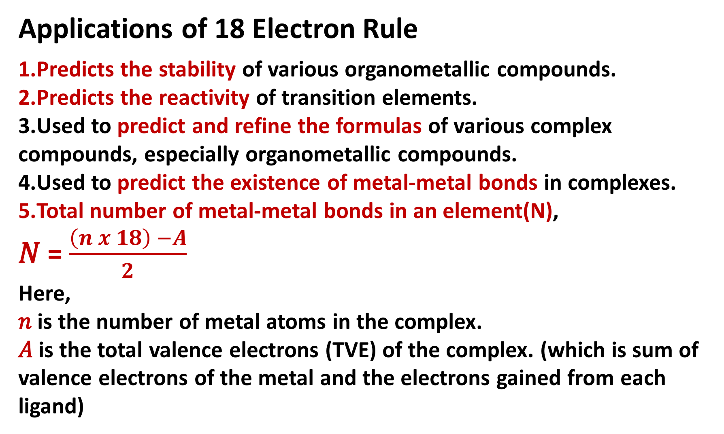
Applications of 18 Electron Rule
Predicts the stability of various organometallic compounds.
Predicts the reactivity of transition elements.
Used to predict and refine the formulas of various complex compounds, especially organometallic compounds.
Used to predict the existence of metal-metal bonds in complexes.
Total number of metal-metal bonds in an element(N),
𝑁 = $\frac{\left(n x 18\right) −A}{2}$
Here,
𝑛 is the number of metal atoms in the complex.
𝐴 is the total valence electrons (TVE) of the complex. (which is sum of valence electrons of the metal and the electrons gained from each ligand)

Slide 4
Exceptions to the 18 electron rule
1. The rule is not applicable to organometallic compounds of main group metals as well as to those of lanthanide and actinide metals.
2. Some organometallic complexes of the early transition metals (e.g. Cp₂TiCl₂, WMe₆, Me₂NbCl₃, CpWOCl₃)
3. Can not predict no. of terminal & bridging Lig (CO)
4. Electronic effects
Late TM with d8 electron configurations e.g. Rh(I), Ir(I), Pd(II), Pt(II) have a strong tendency to form square planar 16 VE complexes. Similarly, d10 complexes tend to form trigonal 16 VE complexes. As the atomic number Z increases, the d-shell is stabilised (lowers in energy). The occupied dz2 orbital (perpendicular to the plane) is no longer involved in ligand bonding.
5. Steric Effects
Early TM have fewer d-electrons to start with than the middle and late TM, so they must achieve their 18e count by coordination of a larger number of ligands. If the ligands involved are too bulky, then low-electron count complexes are formed.

Slide 5
Square planner d⁸ complexes of 4d & 5d transition series of group 9, i.e. Rh(I), Ir (I), and group 10 , i.e. Pd(II), Pt (II), & Cu(III) are 16 e compounds
Neutral atom method Oxidation state method
1. Wilkinson’s catalyst [Cl(PPh₃)₃Rh(I)]:
9(Rh⁰)+1 (for Cl.)+ (3x2)for 2 PPh3 = 16e; 8(Rh⁺¹)+2 (for Cl-)+ (3x2)for 2 PPh3 = 16e
2. Vaska’ complex [Cl(PPh₃)₂(CO)Ir(I)]:
9(Ir⁰) +1(for Cl.) + (2x2)for 2 PPh3 +2 (for CO)= 16e; 8(Ir⁺¹) +2(for Cl-) +(2x2)for 2 PPh3 +2 (for CO)= 16e
3. Zeise’s salt K[Pt(C₂H₄)Cl₃]H₂O: K⁺ + [Pt(C₂H₄)Cl₃]⁻
10(Pt⁰) +3(for 3 Cl.) + 2 for C₂H₄ +1 (for -1)= 16e;
8(Pt⁺²) +6(for 3 Cl⁻) + 2 for C₂H₄ = 16e
16-electron rules

Slide 6
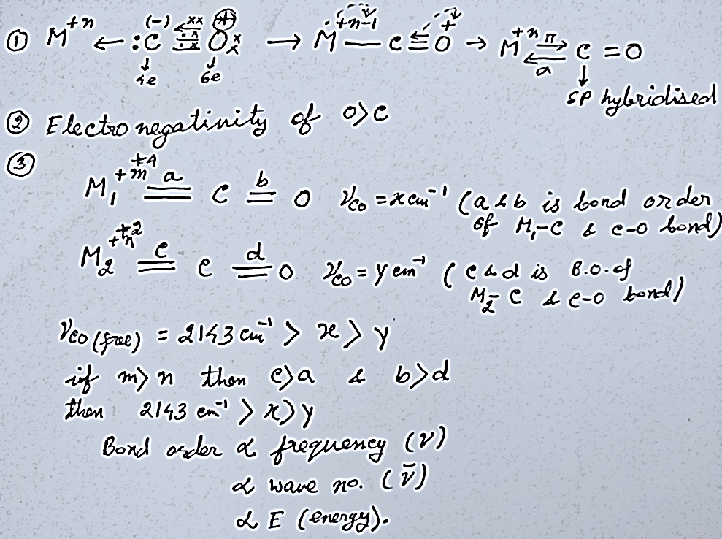

$π$-acceptor properties of CO, synergic effect
More back bonding = More increase of the M-C bond order = More lowering of the C=O bond order = More lower ν _{CO} stretching frequency. ΔE = E₂ – E₁ = hΔν = $\frac{hc}{Δλ}$ = hcΔ$\overline{ν}$, So E$∝\overline{ν}$ (in cm⁻¹)

Slide 7
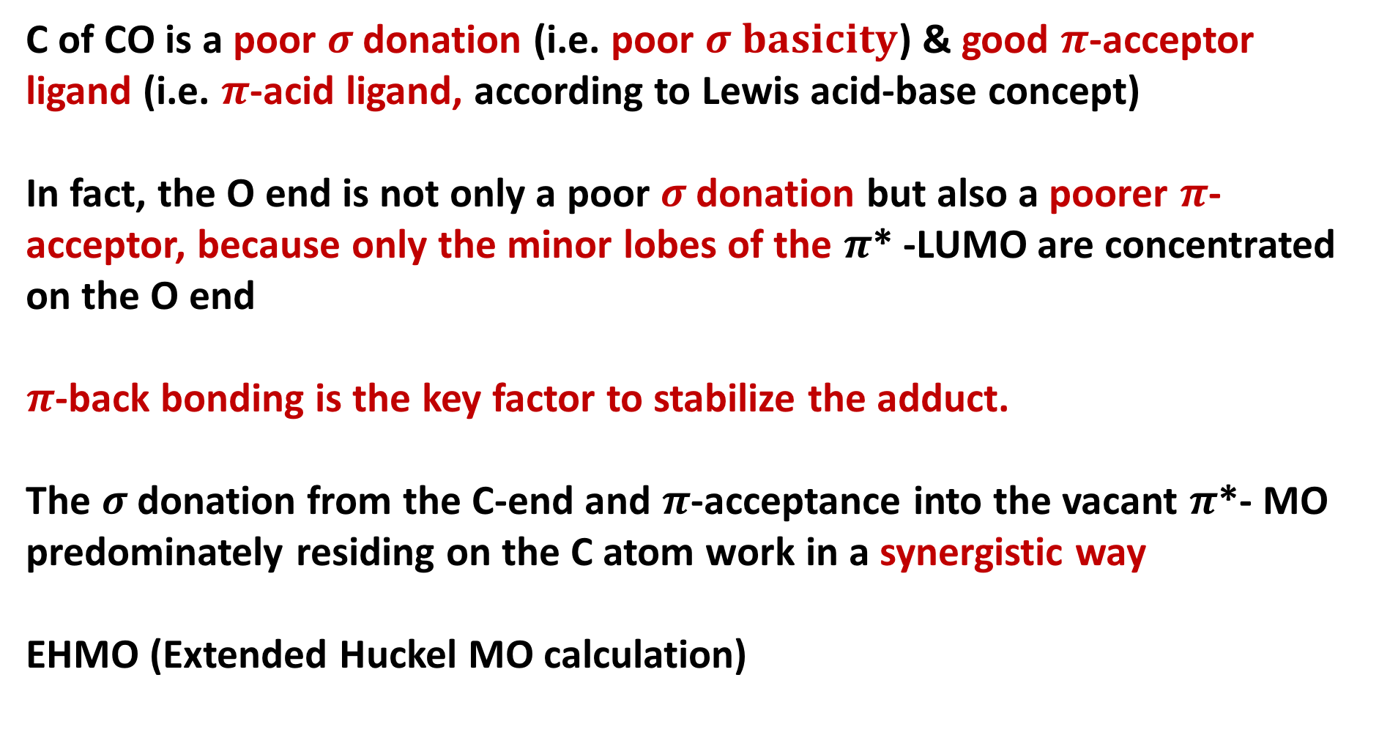
$π$-acceptor properties of CO, synergic effect
C of CO is a poor $σ$donation (i.e. poor $σ basicity$) &good $π$-acceptor ligand (i.e. $π$-acid ligand, according to Lewis acid-base concept)
In fact, the O end is not only a poor $σ$donation but also a poorer $π$-acceptor, because only the minor lobes of the $π$* -LUMO are concentrated on the O end
$π$-back bonding is the key factor to stabilize the adduct.
The $σ$donation from the C-end and $π$-acceptance into the vacant $π$*- MO predominately residing on the C atom work in a synergistic way
EHMO (Extended Huckel MO calculation)

Slide 8
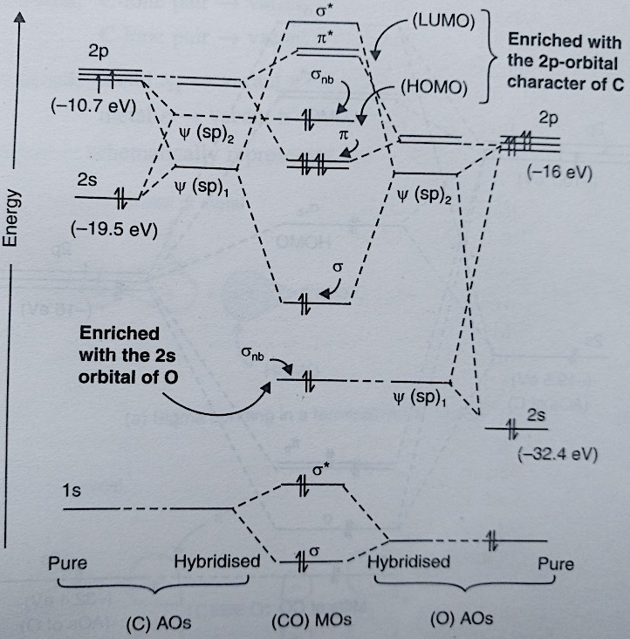
MO energy level diagram of CO
EHMO (Extended
Huckel MO calculation)

Slide 9
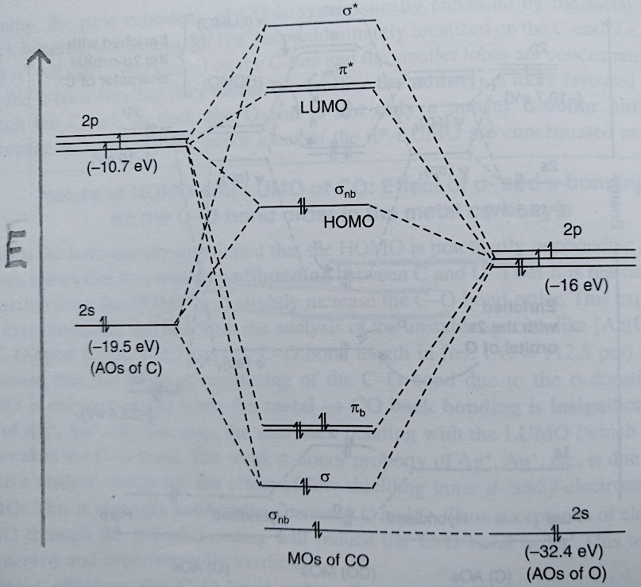
MO energy level diagram of CO

Slide 10
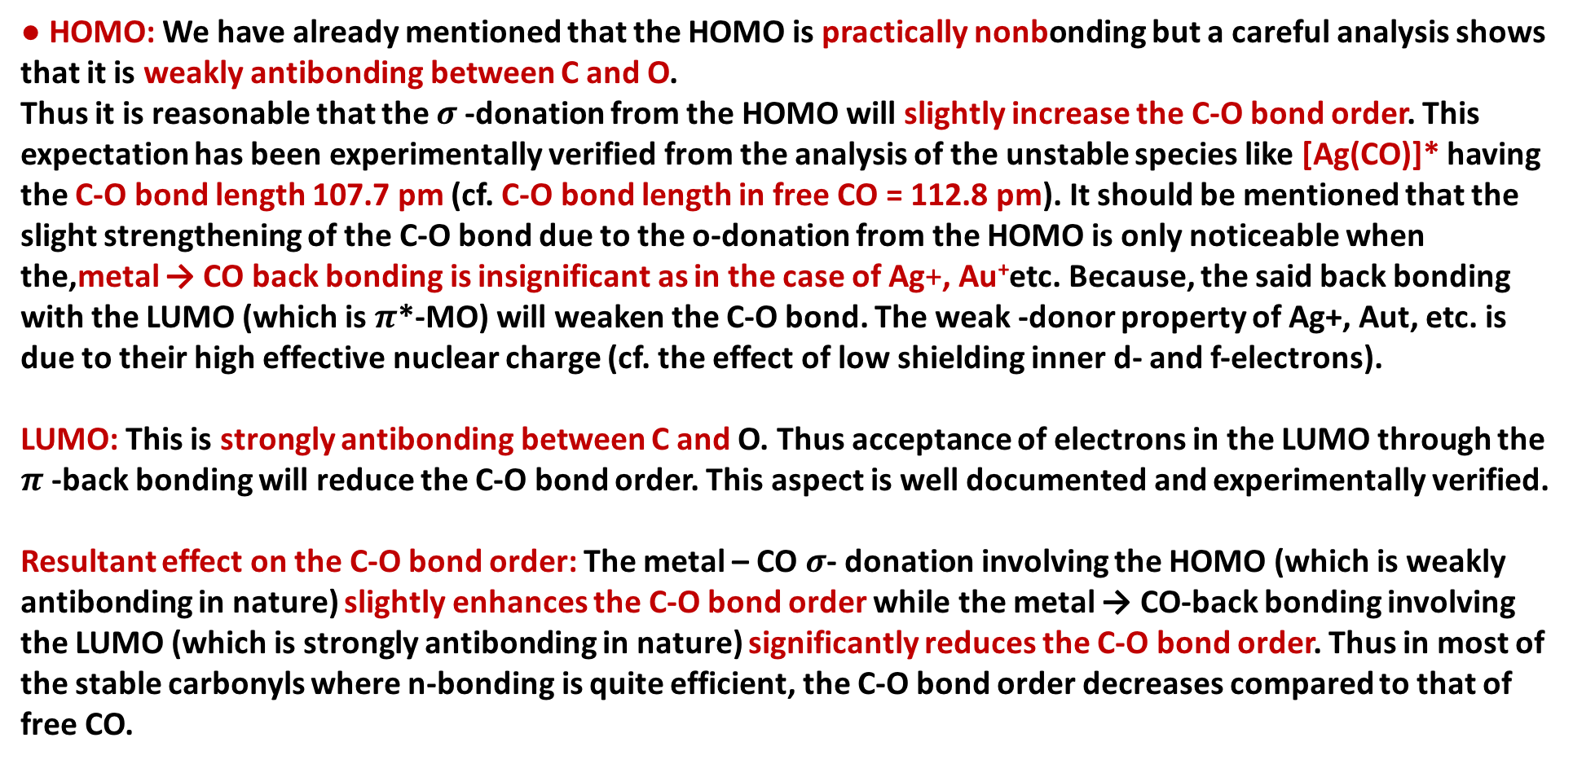
Nature of HOMO and LUMO of CO: Effect of $σ$- and $π$-bonding on the C-O bond order in the metal carbonyls
● HOMO: We have already mentioned that the HOMO is practically nonbonding but a careful analysis shows that it is weakly antibonding between C and O.
Thus it is reasonable that the $σ$-donation from the HOMO will slightly increase the C-O bond order. This expectation has been experimentally verified from the analysis of the unstable species like [Ag(CO)]* having the C-O bond length 107.7 pm (cf. C-O bond length in free CO = 112.8 pm). It should be mentioned that the slight strengthening of the C-O bond due to the o-donation from the HOMO is only noticeable when the,metal → CO back bonding is insignificant as in the case of Ag+, Au⁺etc. Because, the said back bonding with the LUMO (which is $π$*-MO) will weaken the C-O bond. The weak -donor property of Ag+, Aut, etc. is due to their high effective nuclear charge (cf. the effect of low shielding inner d- and f-electrons).
LUMO: This is strongly antibonding between C and O. Thus acceptance of electrons in the LUMO through the $π$-back bonding will reduce the C-O bond order. This aspect is well documented and experimentally verified.
Resultant effect on the C-O bond order: The metal – CO $σ$- donation involving the HOMO (which is weakly antibonding in nature) slightly enhances the C-O bond order while the metal → CO-back bonding involving the LUMO (which is strongly antibonding in nature) significantly reduces the C-O bond order. Thus in most of the stable carbonyls where n-bonding is quite efficient, the C-O bond order decreases compared to that of free CO.

Slide 11
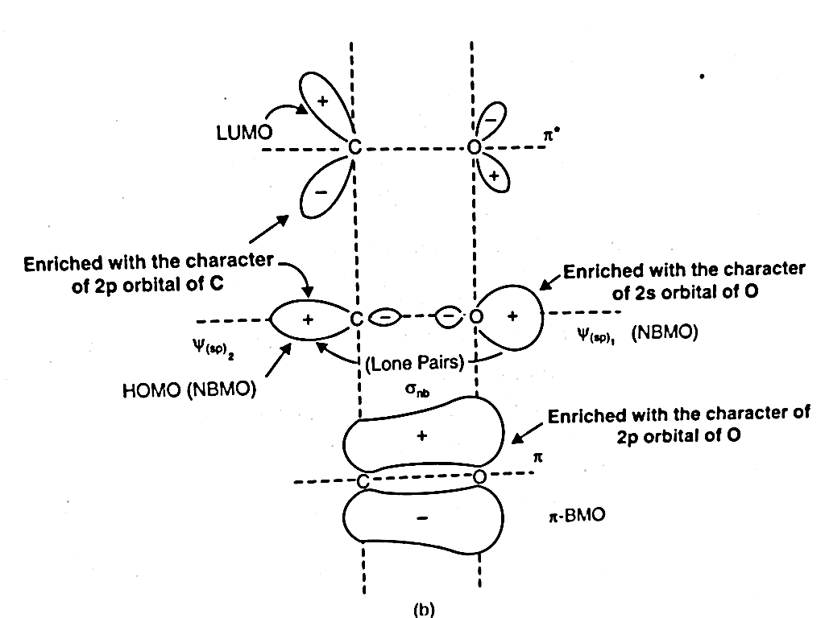
MO energy level diagram of CO

Slide 12
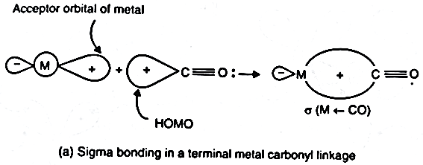
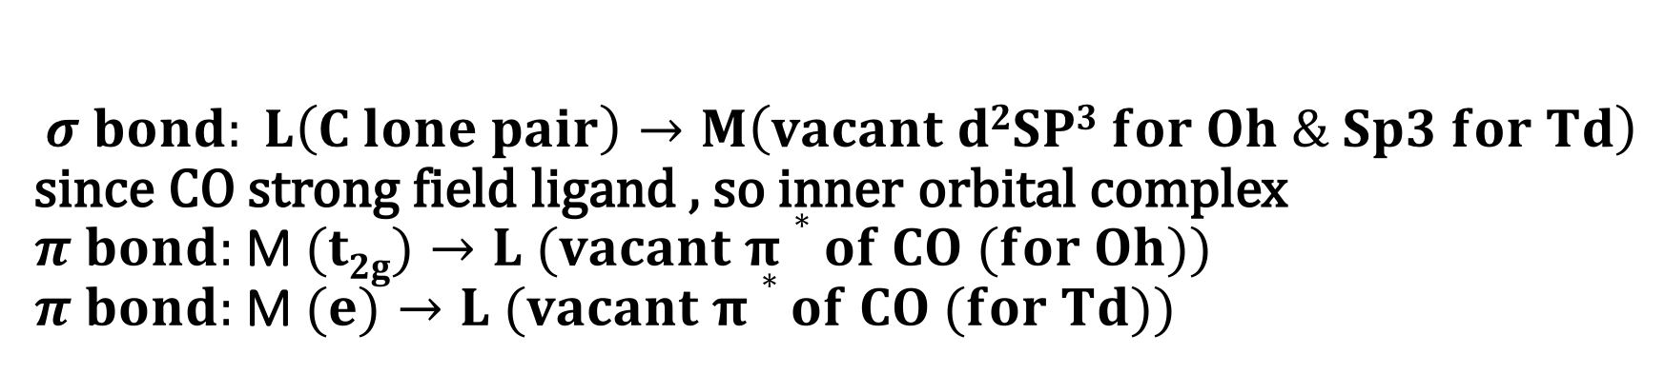
$$σ bond: L\left(C lone pair\right)→M\left(vacant d2SP3 for Oh \& Sp3 for Td\right)$$ since CO strong field ligand , so inner orbital complex
$π bond:$M$(t2g)→L (vacant π∗of CO (for Oh))$
$π bond:$M$(e)→L (vacant π∗of CO (for Td))$
Schematic representation of synergistic $σ$bonding in terminal M-CO bond

Slide 13
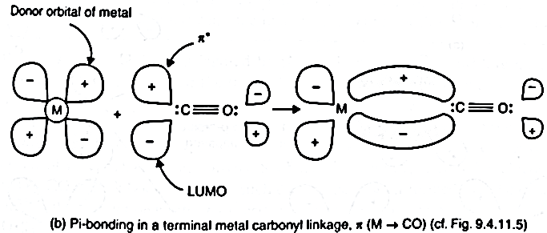
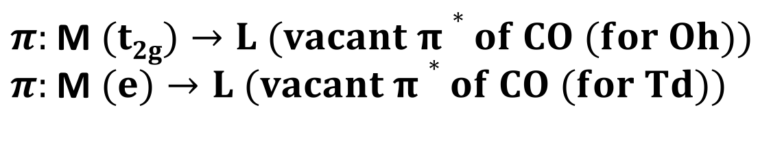
Schematic representation of synergistic $π$ bonding in terminal M-CO bond
$π:$M$(t2g)→L (vacant π∗of CO (for Oh))$
$π:$M$(e)→L (vacant π∗of CO (for Td))$

Slide 14
Use of IR data to explain extent of back bonding
Characterization of Organometallic compounds
X-ray crystallography
Infrared spectroscopy
NMR spectroscopy
Mass spectrometry
Elemental analysis
Others

Slide 15
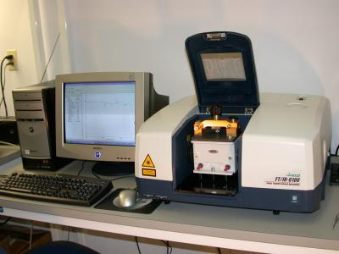
Infrared Spectroscopy- A spectro-analytical tool in chemistry
Infrared (IR) spectroscopy is one of the most common spectroscopic techniques used by organic and inorganic chemists. Simply, it is the absorption measurement of different IR frequencies by a compound positioned in the path of an IR beam. The main goal of IR spectroscopic analysis is to determine the chemical functional groups in the sample. Functional groups are identified based on vibrational modes of the groups such a stretching, bending etc. Different vibrational modes absorb characteristic frequencies of IR radiation. An infrared spectrophotometer is an instrument that passes infrared light through a molecule and produces a spectrum that contains a plot of the amount of light transmitted on the vertical axis against the wave number (in Cm⁻¹) of infrared radiation on the horizontal axis. Absorption of radiation lowers the percentage transmittance value.

Slide 16
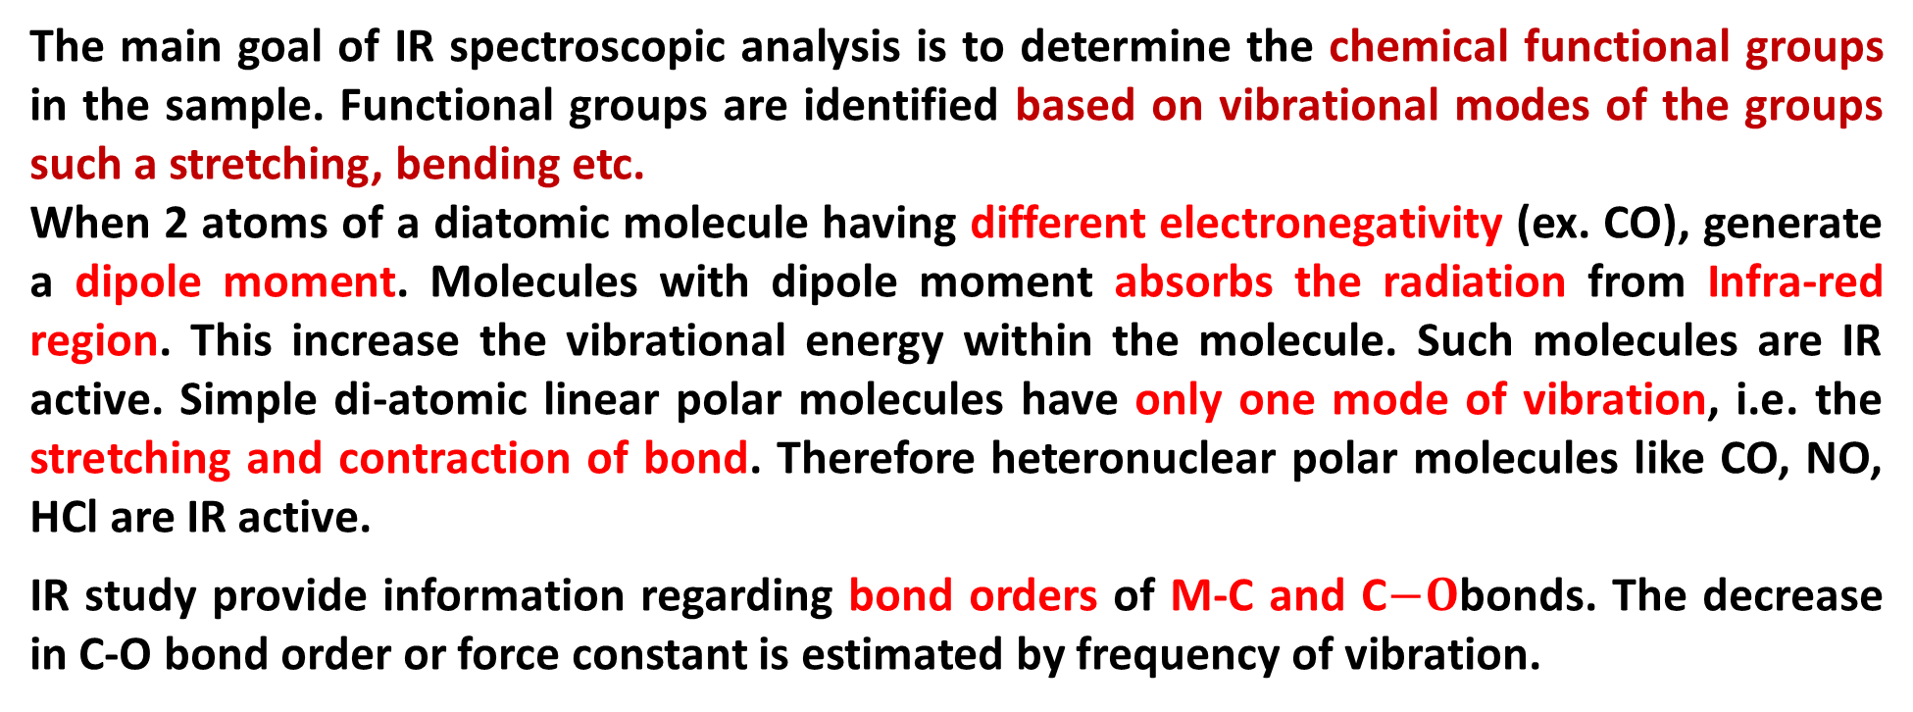
Infrared Spectroscopy- A spectro-analytical tool in chemistry
The main goal of IR spectroscopic analysis is to determine the chemical functional groups in the sample. Functional groups are identified based on vibrational modes of the groups such a stretching, bending etc.
When 2 atoms of a diatomic molecule having different electronegativity (ex. CO), generate a dipole moment. Molecules with dipole moment absorbs the radiation from Infra-red region. This increase the vibrational energy within the molecule. Such molecules are IR active. Simple di-atomic linear polar molecules have only one mode of vibration, i.e. the stretching and contraction of bond. Therefore heteronuclear polar molecules like CO, NO, HCl are IR active.
IR study provide information regarding bond orders of M-C and C$−O$bonds. The decrease in C-O bond order or force constant is estimated by frequency of vibration.

Slide 17
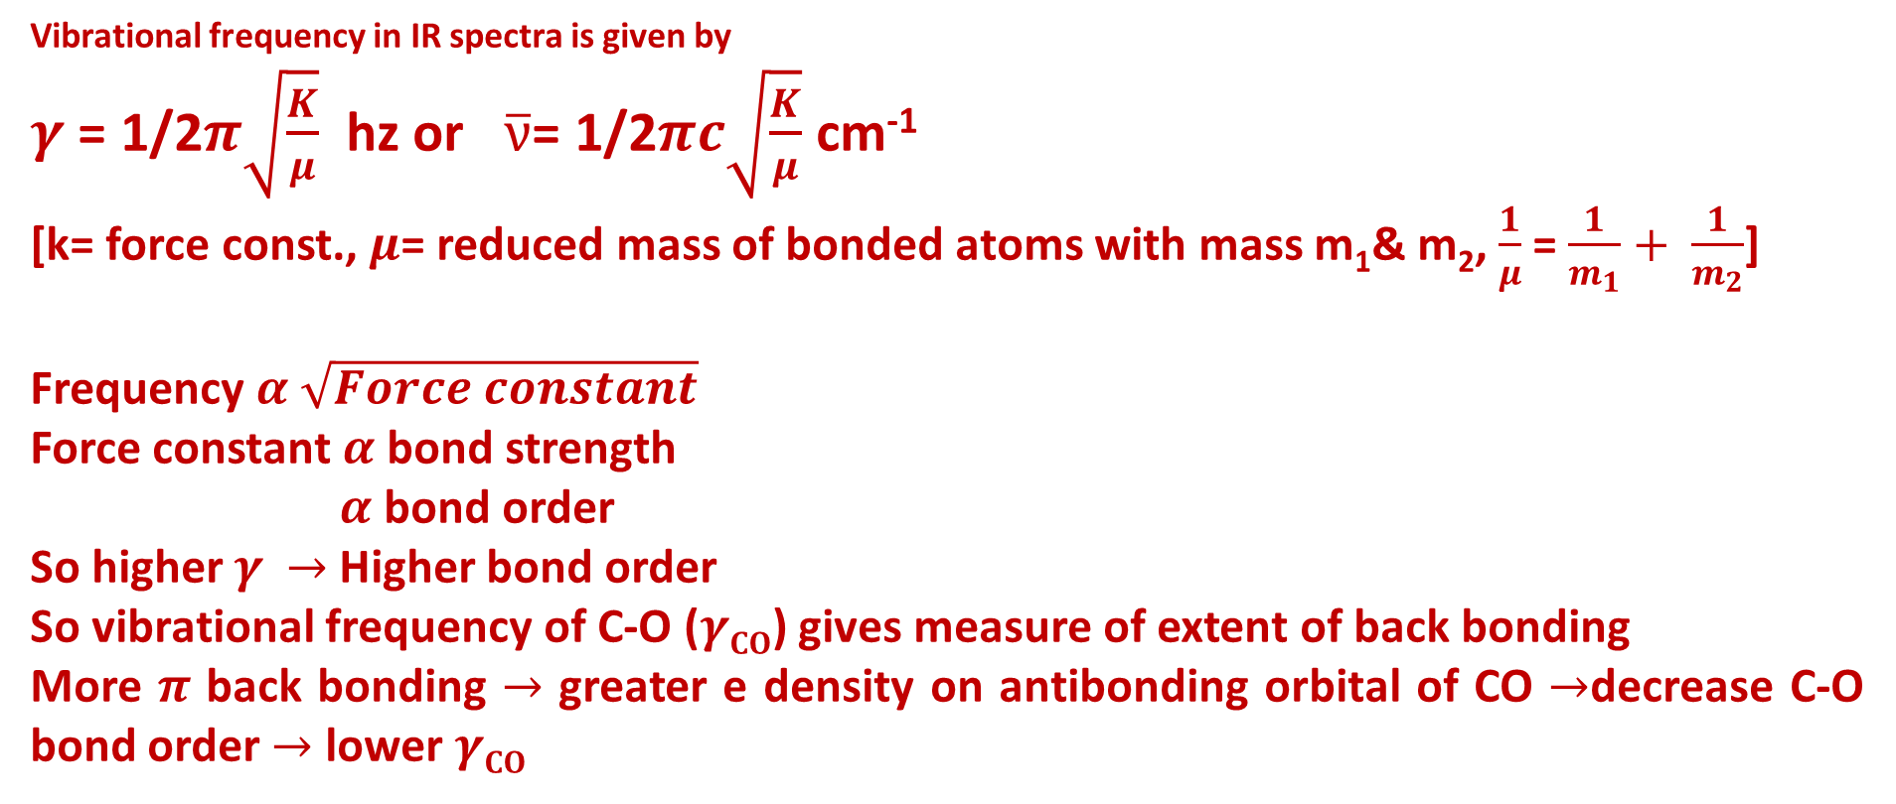
Vibrational frequency in IR spectra is given by
$γ$ = 1/2$π\sqrt{\frac{K}{μ}}$ hz or $\overline{ν}$= 1/2$πc\sqrt{\frac{K}{μ}}$ cm⁻¹
[k= force const., $μ$= reduced mass of bonded atoms with mass m₁& m₂, $\frac{1}{μ}$ = $\frac{1}{m_{1}}+ \frac{1}{m_{2}}$]
Frequency $α$ $\sqrt{Force constant}$
Force constant $α$ bond strength
$α$ bond order
So higher $γ$ $→$ Higher bond order
So vibrational frequency of C-O ($γCO$) gives measure of extent of back bonding
More $π$ back bonding $→$ greater e density on antibonding orbital of CO $→$decrease C-O bond order $→$ lower $γCO$

Slide 18
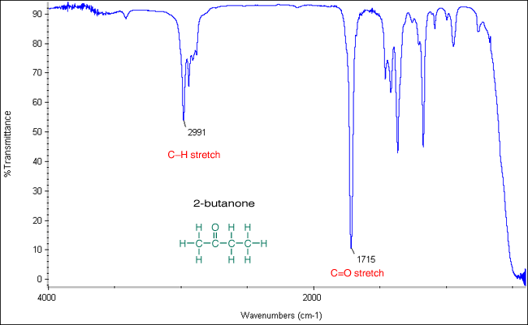
Infrared Spectroscopy- A spectro-analytical tool in chemistry

Slide 19

Infrared Spectroscopy- A spectro-analytical tool in chemistry
ΔE = E₂ – E₁ = hΔν = $\frac{hc}{Δλ}$ = hcΔ$\overline{ν}$, So E$∝\overline{ν}$ (in cm⁻¹)
IR stretching frequency as diagonestic tool to identify ligational motifs, i.e. terminal or bridging CO, single or double or triple bridge CO
$γCO$(in free CO) >$γCO$(in terminal CO) >$γCO$(in $μ2−CO$) >$γCO$(in $μ3−CO$ )
2143 cm⁻¹(C$≡$O) M=C=O (2e-2c) (3c-2e) (4c-2e)

Slide 20
Terminal versus bridging carbonyls
2000 cm-1
2018, 1826 cm-1
1620 cm-1

Slide 21
Infrared Spectroscopy- Spectra of Metal Carbonyls
The range in which the band appears decides bridging or terminal .
The number of bands is only related to the symmetry of the molecule
^{terminal}
bridging
^{terminal}

Slide 22
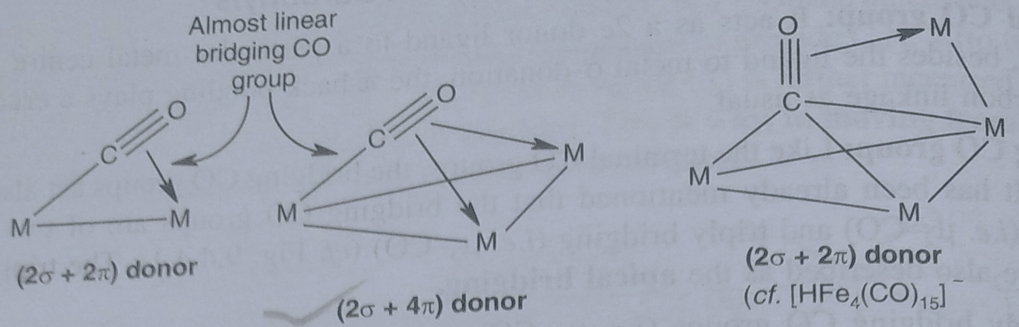
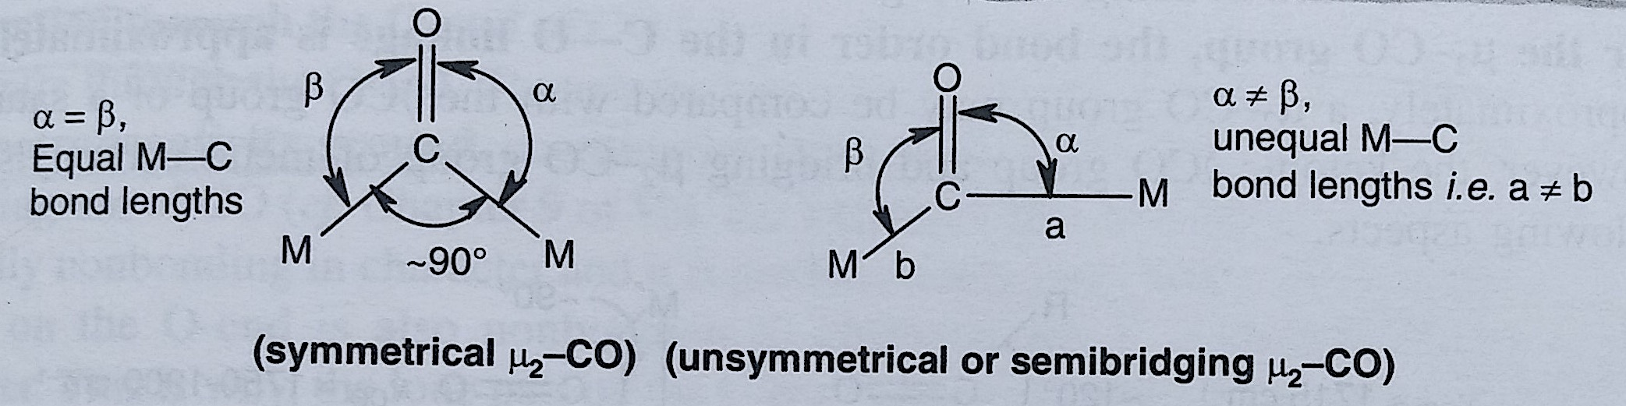
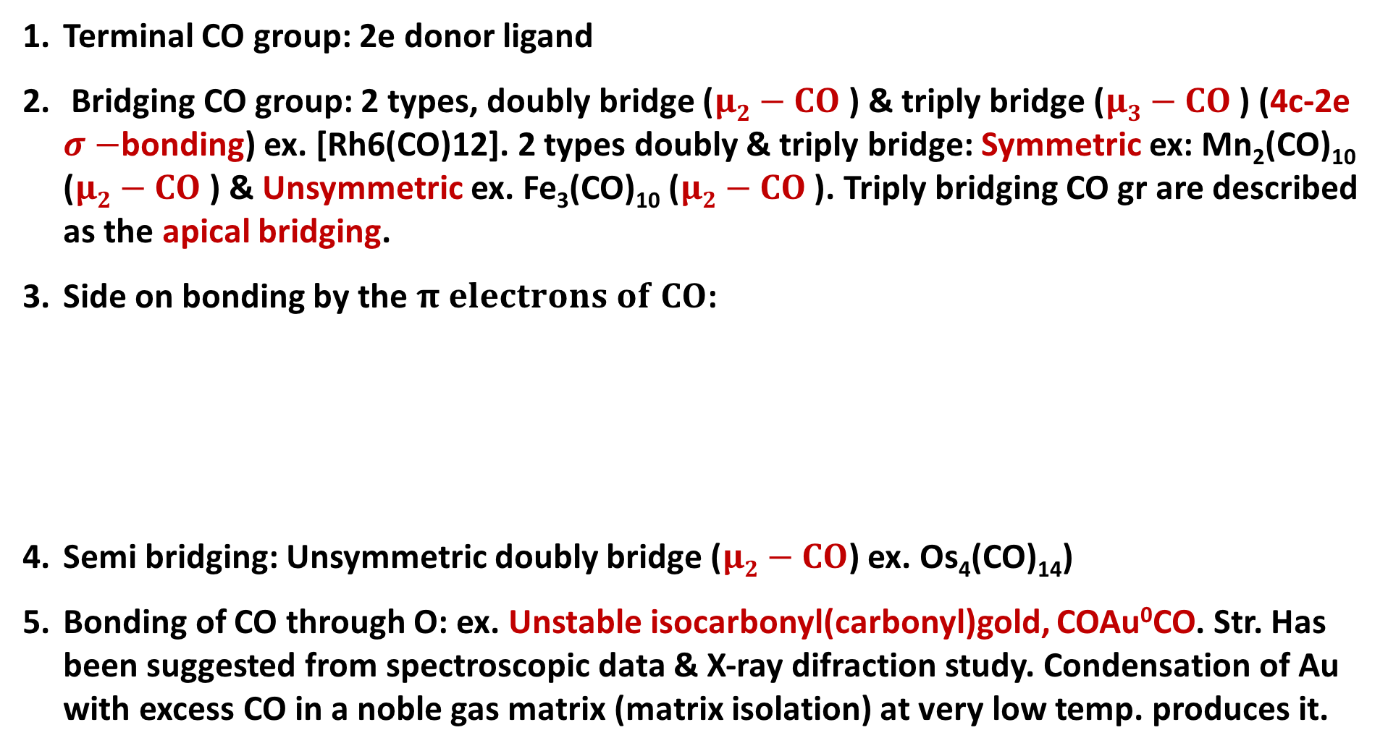
Coordinating Behaviours of the CO group in Carbonyls
Terminal CO group: 2e donor ligand
Bridging CO group: 2 types, doubly bridge ($μ2−CO$) & triply bridge ($μ3−CO$) (4c-2e $σ−$bonding) ex. [Rh6(CO)12]. 2 types doubly & triply bridge: Symmetric ex: Mn₂(CO)₁₀($μ2−CO$) &Unsymmetric ex. Fe₃(CO)₁₀ ($μ2−CO$). Triply bridging CO gr are described as the apical bridging.
Side on bonding by the $π electrons of CO$:
Semi bridging: Unsymmetric doubly bridge ($μ2−CO$) ex. Os₄(CO)₁₄)
Bonding of CO through O: ex. Unstable isocarbonyl(carbonyl)gold, COAu⁰CO. Str. Has been suggested from spectroscopic data & X-ray difraction study. Condensation of Au with excess CO in a noble gas matrix (matrix isolation) at very low temp. produces it.

Slide 23
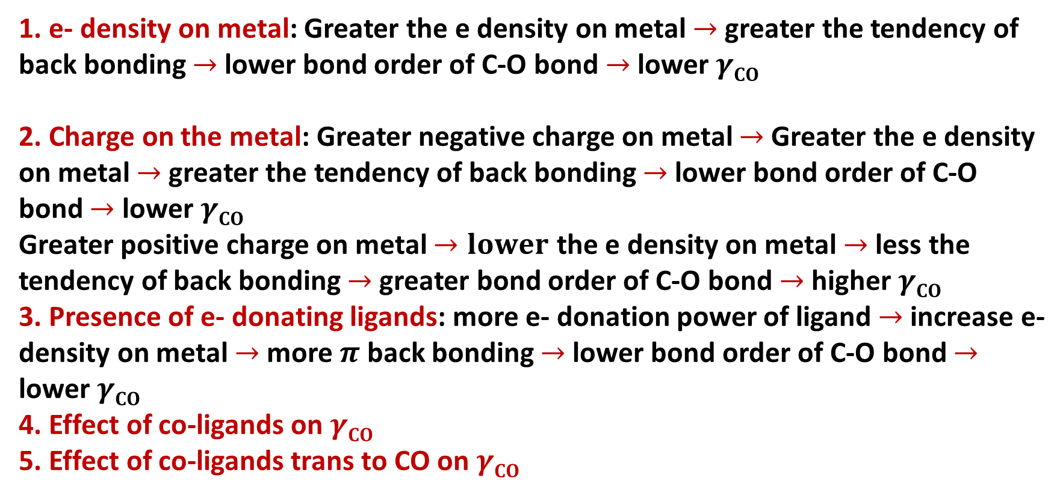
Factors which affect ν_{CO} stretching frequencies
1. e- density on metal: Greater the e density on metal $→$ greater the tendency of back bonding $→$ lower bond order of C-O bond $→$ lower $γCO$
2. Charge on the metal: Greater negative charge on metal $→$Greater the e density on metal $→$ greater the tendency of back bonding $→$ lower bond order of C-O bond $→$ lower $γCO$
Greater positive charge on metal $→lower$ the e density on metal $→$ less the tendency of back bonding $→$ greater bond order of C-O bond $→$ higher $γCO$
3. Presence of e- donating ligands: more e- donation power of ligand $→$ increase e- density on metal $→$ more $π$ back bonding $→$ lower bond order of C-O bond $→$ lower $γCO$
4. Effect of co-ligands on $γCO$
5. Effect of co-ligands trans to CO on $γCO$

Slide 24
Factors which affect ν_{CO} stretching frequencies
Charge on the metal
Variation in ν_{CO} (cm^{–1}) of the first row transition metal carbonyls
 | free CO: 2143
Ni(CO)₄: 2057
Co(CO)₄⁻ : 1890 |  | Co₂(CO)₈ :2044(av, ter)
[Fe(CO)₄]²⁻: 1815 |  | Fe(CO)₅: 2030
[Mn(CO)₄]³⁻1600,1790 | Mn(CO)₆ + 2098 | Mn₂(CO)₁₀ 2013 (av)
[Cr(CO)₄]⁴⁻ 1462,1657 | Cr(CO)₆ 2000
 | V(CO)₆¯: 1860 | V(CO)₆: 1976
 | Ti(CO)₆²⁻ : 1747
As the electron density on a metal centre increases, more π-back­bonding to the CO ligand(s) takes place. This weakens the C–O bond further as more electron density is pumped into the empty π* anti-bonding carbonyl orbital. This increases the M–C bond order and reduces the
C-O bond order. That is, the resonance structure M=C=O becomes more dominant.
More back bonding

Slide 25
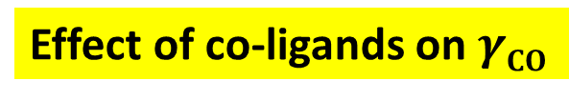
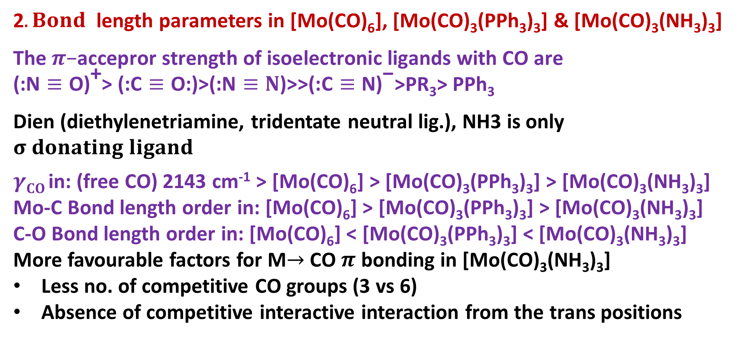
Effect of co-ligands on $γCO$
2$. Bond$ length parameters in [Mo(CO)₆], [Mo(CO)₃(PPh₃)₃] &[Mo(CO)₃(NH₃)₃]
$$\text{The} π\text{−}\text{accepror} \text{strength} \text{of} \text{isoelectronic} \text{ligands} \text{with} \text{CO} \text{are}$$
$\text{(:}\text{N}≡\text{O}\text{)}\text{+}\text{> (:}\text{C}≡\text{O}\text{:)>(:}\text{N}≡N\text{)>>(:}\text{C}≡\text{N}\text{)}\text{−}$>PR₃> PPh₃
Dien (diethylenetriamine, tridentate neutral lig.), NH3 is only $σ donating ligand$
$γCO$in: (free CO) 2143 cm⁻¹> [Mo(CO)₆] > [Mo(CO)₃(PPh₃)₃] > [Mo(CO)₃(NH₃)₃] Mo-C Bond length order in: [Mo(CO)₆] > [Mo(CO)₃(PPh₃)₃] > [Mo(CO)₃(NH₃)₃]
C-O Bond length order in: [Mo(CO)₆] <[Mo(CO)₃(PPh₃)₃] <[Mo(CO)₃(NH₃)₃]
More favourable factors for M$→$ CO $π$ bonding in [Mo(CO)₃(NH₃)₃]
Less no. of competitive CO groups (3 vs 6)
Absence of competitive interactive interaction from the trans positions

Slide 26
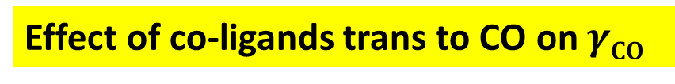
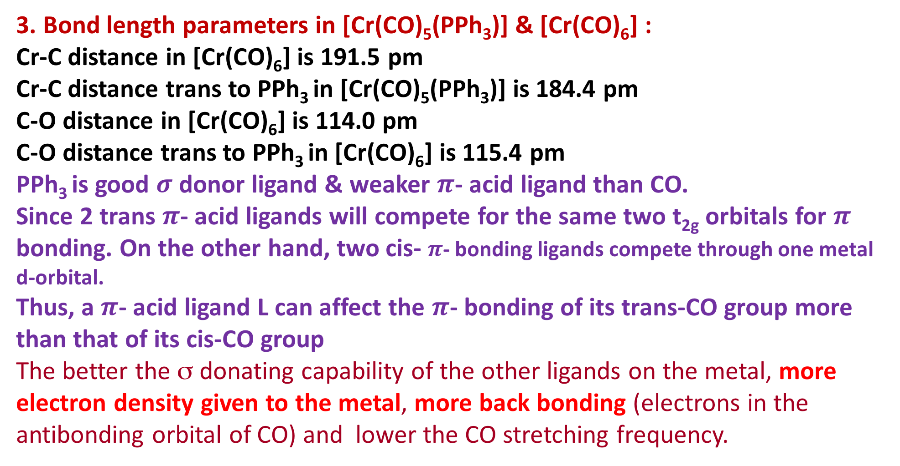
Effect of co-ligands trans to CO on $γCO$
3. Bond length parameters in [Cr(CO)₅(PPh₃)] &[Cr(CO)₆] :
Cr-C distance in [Cr(CO)₆] is 191.5 pm
Cr-C distance trans to PPh₃ in [Cr(CO)₅(PPh₃)] is 184.4 pm
C-O distance in [Cr(CO)₆] is 114.0 pm
C-O distance trans to PPh₃ in [Cr(CO)₆] is 115.4 pm
PPh₃ is good $σ$ donor ligand & weaker $π$- acid ligand than CO.
Since 2 trans $π$- acid ligands will compete for the same two t_{2g} orbitals for $π$ bonding. On the other hand, two cis-$π$- bonding ligands compete through one metal d-orbital.
Thus, a $π$- acid ligand L can affect the $π$- bonding of its trans-CO group more than that of its cis-CO group
The better the σ donating capability of the other ligands on the metal, more electron density given to the metal, more back bonding (electrons in the antibonding orbital of CO) and lower the CO stretching frequency.

Slide 27
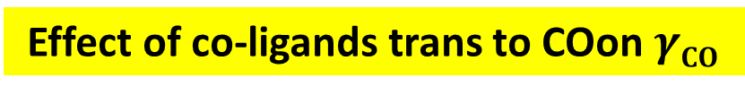
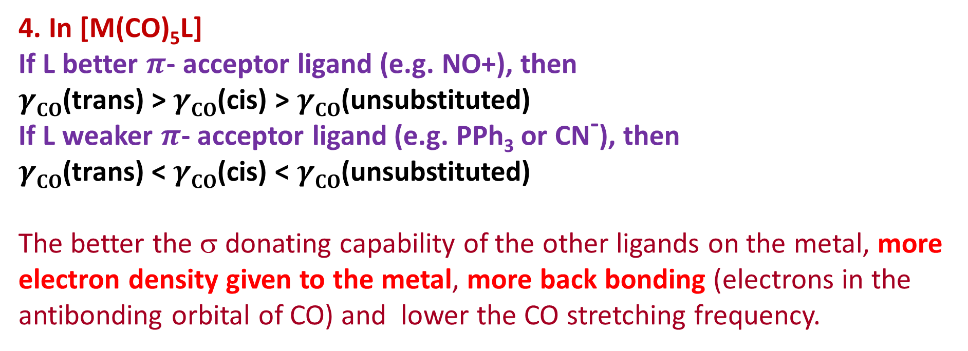
Effect of co-ligands trans to COon $γCO$
4. In [M(CO)₅L]
If L better $π$- acceptor ligand (e.g. NO+), then
$γCO$(trans) > $γCO$(cis) > $γCO$(unsubstituted)
If L weaker $π$- acceptor ligand (e.g. PPh₃ or CN⁻), then
$γCO$(trans) < $γCO$(cis) < $γCO$(unsubstituted)
The better the σ donating capability of the other ligands on the metal, more electron density given to the metal, more back bonding (electrons in the antibonding orbital of CO) and lower the CO stretching frequency.

Slide 28
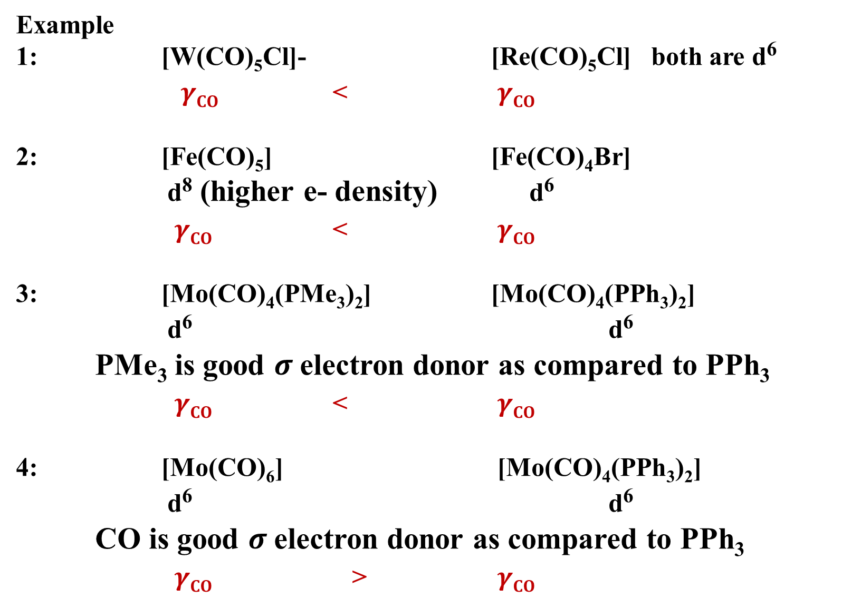
Example
1: [W(CO)₅Cl]- [Re(CO)₅Cl] both are d⁶
$γCO$ < $γCO$
2: [Fe(CO)₅] [Fe(CO)₄Br]
d⁸ (higher e- density) d⁶
$γCO$ < $γCO$
3: [Mo(CO)₄(PMe₃)₂] [Mo(CO)₄(PPh₃)₂]
d⁶ d⁶
PMe₃ is good $σ$electron donor as compared to PPh₃
$γCO$ < $γCO$
4: [Mo(CO)₆] [Mo(CO)₄(PPh₃)₂]
d⁶ d⁶
CO is good $σ$electron donor as compared to PPh₃
$γCO$ > $γCO$

Slide 29
Reference
Ashim K Das & Mahua Das, Fundamental Concept of Inorganic Chemistry, CBC Publishers & Distributors, Volume 6, First Edition: 2014
Ashim K Das & Mahua Das, Fundamental Concept of Inorganic Chemistry, CBC Publishers & Distributors, Volume 3, First Edition: 2014
Wahid U. Malik, G. D. Tuli & R. D. Madan, Selected topics in inorganic chemistry, S. Chand & Company Ltd, first edition
Christoph Elschenbroich, Organometallics, 3rd Completely Revised and Extended Edition, Wiley-VCH Verlag GmbH & Co. KGaA, Weinheim, Germany, 2006
Robert H Crabtree, The Organometallic Chemistry of the Transition Metals, 4th Edition, John Wiley & Sons, Inc., Hoboken, New Jersey, 2005
B D Gupta and A J Elias, Basic Organometallic Chemistry, University Press (India) Pvt Ltd., 2010

Slide 30
Thank you

